Slide 1

Travelling Salesman optimization problem Using ACO
TEAM MEMBERS
2010030536-C Shravan Sai Ram
2010030358 –B Avinash
2010030513-Akhil

Slide 2
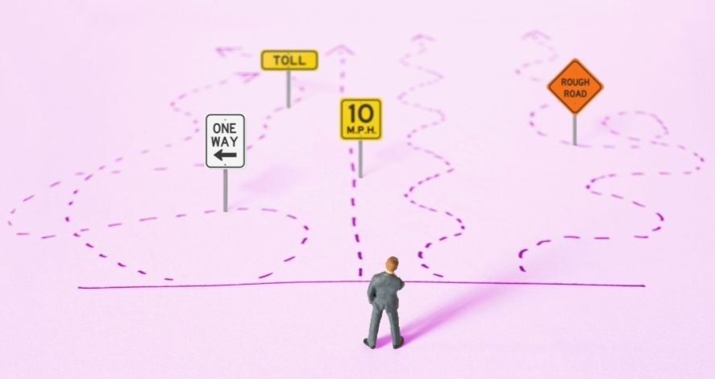
Problem Statement
The travelling salesman problem consists of a salesman and a set of cities.
The salesman has to visit each one of the cities starting from a certain one and returning to the same city.
The challenge of the problem is that the travelling salesman wants to minimize the total length of the trip.
Typically travelling salesman problem is represented by weighted graph.

Slide 3
Introduction
The Travelling salesman problem (TSP) is one of the most fundamental N P-complete combinatorial optimization problems
The TSP has several applications even in its purest formulation, such as planning, logistics, and the manufacture of microchips.
Slightly modified, it appears as a sub-problem in many areas, such as DNA sequencing.
In these applications, the concept city represents, for example, customers, soldering points, or DNA fragments, and the concept distance represents travelling times or cost, or a similarity measure between DNA fragments.
The TSP also appears in astronomy, as astronomers observing many sources will want to minimize the time spent moving the telescope between the sources; in such problems, the TSP can be embedded inside an optimal control problem.

Slide 4
Literature Survey
S No | Title | Author | Journal and Year | Conclusion | Reference Link
1 | ACO Algorithms for the Traveling Salesman Problem | Thomas STUTZLE and Marco DORIGO | IRIDIA, Universit´e Libre de Bruxelles, Belgium | Hybridization of ACO algorithms have clearly showed a lot of improvement in results for various problems. | https://staff.washington.edu/paymana/swarm/stutzle99-eaecs.pdf
2 | Evolution of Ant Colony Optimization Algorithm | Aleem Akhtar Asif | SEECS-NUST, ISLAMABAD | The performance of ACO algorithm has been integrated with other metaheuristics and inter-programming techniques.

Slide 5
S No | Title | Author | Journal and Year | Conclusion | Reference Link
3 | Ant Colony Optimization With Local Search for Dynamic Traveling Salesman Problems | Michalis Mavrovouniotis Felipe M. Müller, and Shengxiang Yang, | IEEE TRANSACTIONS ON CYBERNETICS, VOL. 47, NO. 7, JULY 2017 | The dynamic version of other routing problems that are basically variations or direct extensions of the fundamental TSP | https://ieeexplore.ieee.org/document/7490403

Slide 6
How can we solve the problem
ACO-Ant Colony Optimisation
First, each ant in the colony constructs a solution based on previously deposited pheromone trails.
Next ants will lay pheromone trails on the components of their chosen solution, depending on the solution’s quality.
An ant will often follow the strongest pheromone trail when constructing a solution.
However, for the ant to consider solutions other than the current best, a small amount of randomness is required in its decision process.
In addition to this, a heuristic value is also computed and considered helping to guide the search process towards the best solutions.
In the example of the traveling salesman problem this heuristic will typically be the length of the edge between the city being considered - the shorter the edge, the more likely an ant will pick it.

Slide 7
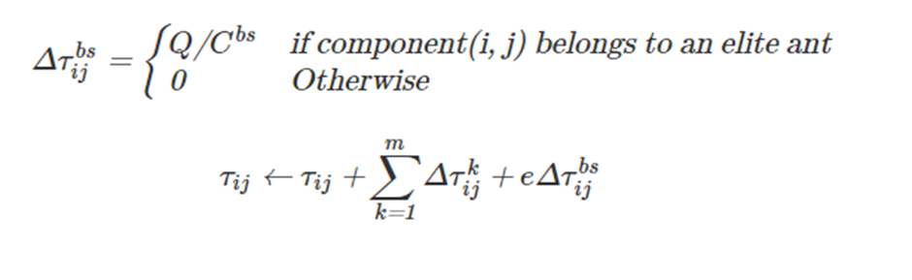
Algorithm Used
Elitist
In elitist ACO systems, either the best current, or global best ant, deposits extra pheromone during it's local pheromone update procedure. This encourages the colony to refine it's search around solutions which have a track record of being high quality. If all goes well, this should result in better search performance.
Where, e is a parameter used to adjust the amount of extra pheromone given to the best (or "elite") solution.
The math for the elitist local pheromone is :

Slide 8
Tools And Programming Language
Pycharm
Python

Slide 9
DataSet

Slide 10
Conclusion
Travelling salesman problem is one of the most extensively studied optimization problem that is used to find the shortest possible route.
By knowing or solving the Travelling salesman problem we get the optimal travelling distance/path cost.
We should know which appropriate method to be used while solving TSP.

Slide 11
THANK YOU

